Slide 1
Dow Jones Index Data Set https://github.com/hendrixjoseph/MachineLearning
Joseph Hendrix
CS7830 Machine Learning
Fall 2016

Slide 2
Data Set
Dow Jones Index Data Set (http://archive.ics.uci.edu/ml/datasets/Dow+Jones+Index)
Weekly data from the first 6 months of 2011
January 7, 2011 through June 24, 2011
25 weeks
16 attributes, many of which can be derived from others
quarter from date
change and percent change from previous / next week
Stock symbol, date, open, high, low, close, days to next dividend, percent return next dividend

Slide 3
Motivation
“Buy low, sell high”
You WANT to buy a stock that will INCREASE in price
E.g. buy a $1000 shares of a stock for $25 a share = 40 shares
Sell said stock when it reaches $30 a share = $1200
$200 profit
You DO NOT want to buy a stock that will DECREASE in price
E.g. buy a $1000 shares of a stock for $25 a share = 40 shares
Sell said stock when it reaches $20 a share = $800
$200 loss

Slide 4
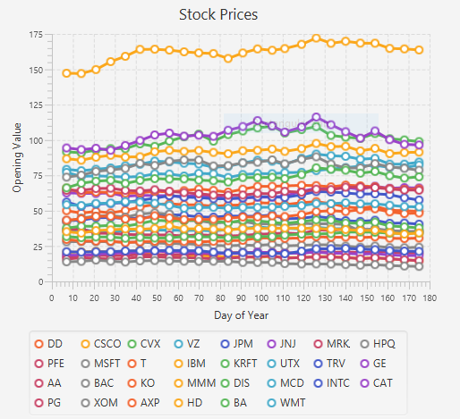
Motivation (continued)
How do we know if the price will increase or decrease?
We don’t:
“past performance does not necessarily predict future results”
All my data is from the past!
Maybe it can still help us guess

Slide 5
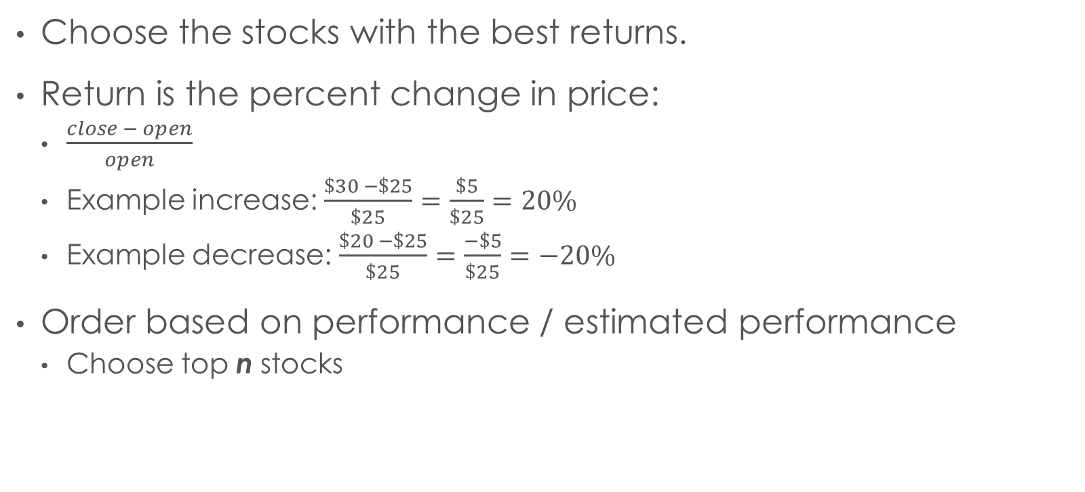
Objective
Choose the stocks with the best returns.
Return is the percent change in price:
$\frac{close − open}{open}$
Example increase: $\frac{\$30 −\$25}{\$25}=\frac{\$5}{\$25}=20\%$
Example decrease: $\frac{\$20 −\$25}{\$25}=\frac{−\$5}{\$25}=−20\%$
Order based on performance / estimated performance
Choose top n stocks

Slide 6
Classification
A stock is “positive” if it’s return is positive
A stock is “negative” if it’s return is zero or negative
This is for the true positive, false negative, etc. calculations.
Alternatives:
Positive if the return is greater than inflation, negative otherwise
Positive if the return is greater than the index, negative otherwise
Index is the average return of all the stocks in the set.
Oftentimes weighted.

Slide 7
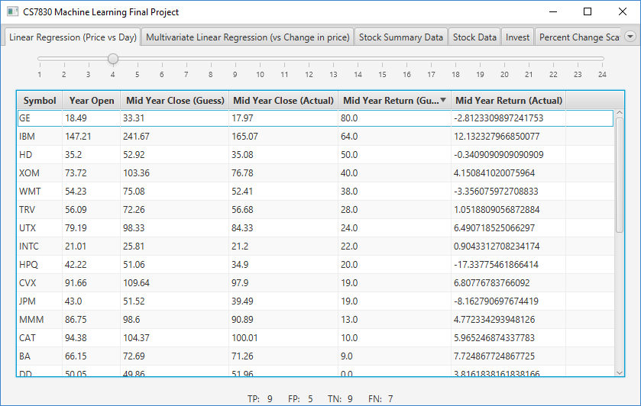

Test 1
Used
The Apache Commons Mathematics Library: Simple regression
http://commons.apache.org/proper/commons-math/userguide/stat.html#a1.4_Simple_regression
Input: Day of Year
Output: Closing value
Training: first n weeks
Top ten:
TP | 6
FP | 4
TN | 0
FN | 0
P | 0.6
R | 1.0
F1 | 0.75

Slide 8
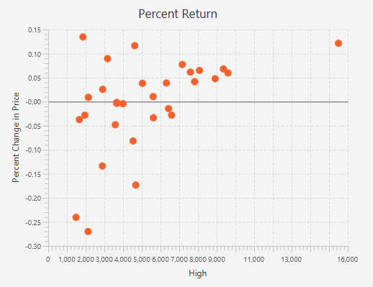
Percent Return Vs…

Slide 9
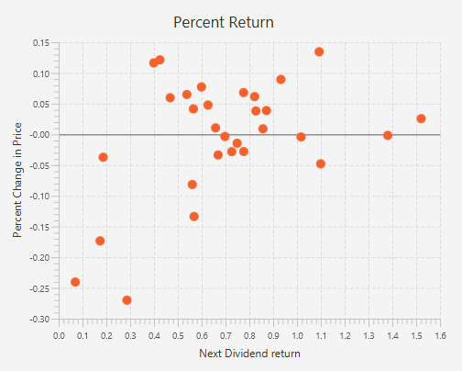
Percent Return Vs…

Slide 10
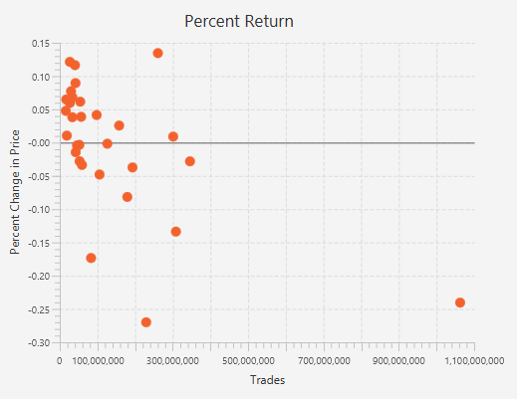
Percent Return Vs…

Slide 11
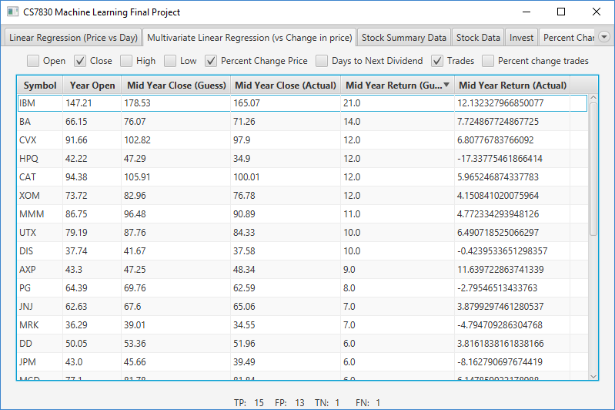
Test 2
Used
The Apache Commons Mathematics Library: Multiple linear regression
http://commons.apache.org/proper/commons-math/userguide/stat.html#a1.5_Multiple_linear_regression
If this week’s price is…then next week’s price is…
Top ten:
TP | 8
FP | 2
TN | 0
FN | 0
P | 0.8
R | 1.0
F1 | 0.88

Slide 12
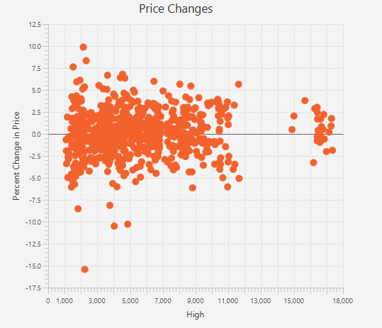
Percent Change In Price Vs…

Slide 13
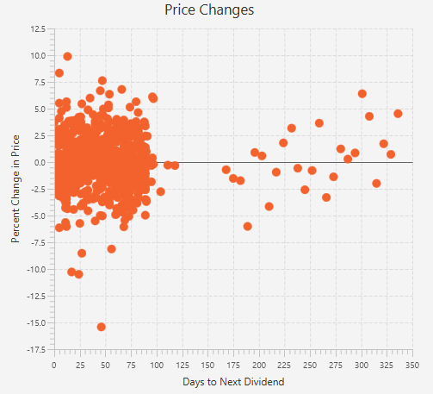
Percent Change In Price Vs…

Slide 14
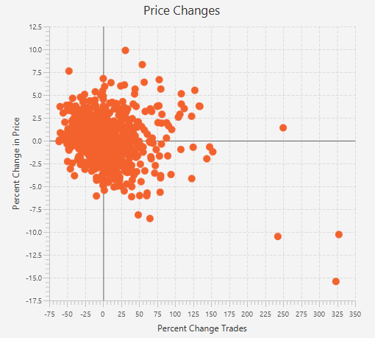
Percent Change In Price Vs…

Slide 15
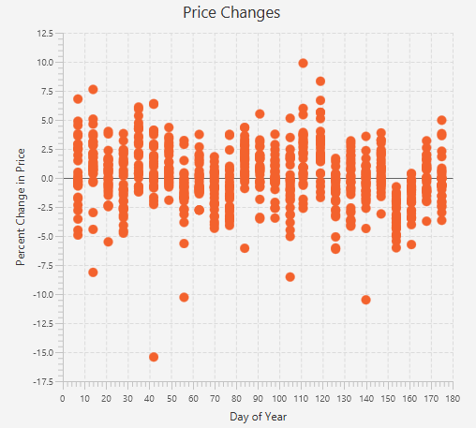
Percent Change In Price Vs…

Slide 16
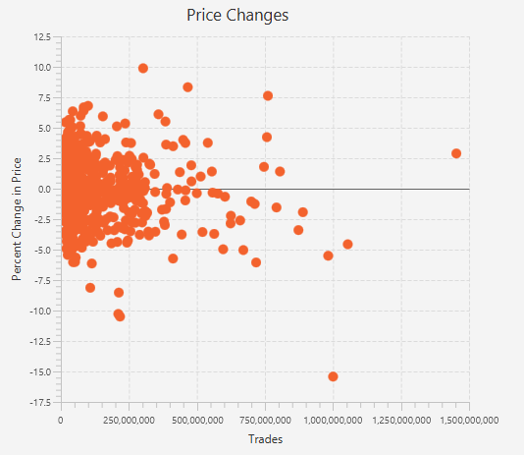
Percent Change In Price Vs…

Slide 17
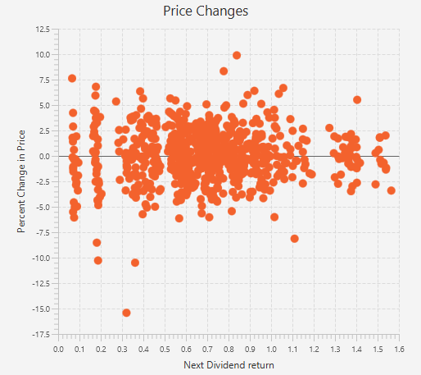
Percent Change In Price Vs…

Slide 18
Sources
Dow Jones Index Data Set
http://archive.ics.uci.edu/ml/datasets/Dow+Jones+Index
“past performance does not necessarily predict future results”
U.S. Securities and Exchange Commission. (2010, July 28). Mutual Funds, Past Performance. https://www.sec.gov/answers/mperf.htm
This image:
Wikipedia: Precision and recall - Definition (classification context) https://en.wikipedia.org/wiki/Precision_and_recall#Definition_.28classification_context.29

Slide 19
Questions…?

